Slide 1

New Teachers,
Welcome to RPS!
Technology Survival Guide for Teachers New to RPS

Slide 2

ADMINISTRATIVE RESOURCES
Technology Survival Guide for Teachers new to RPS

Slide 3
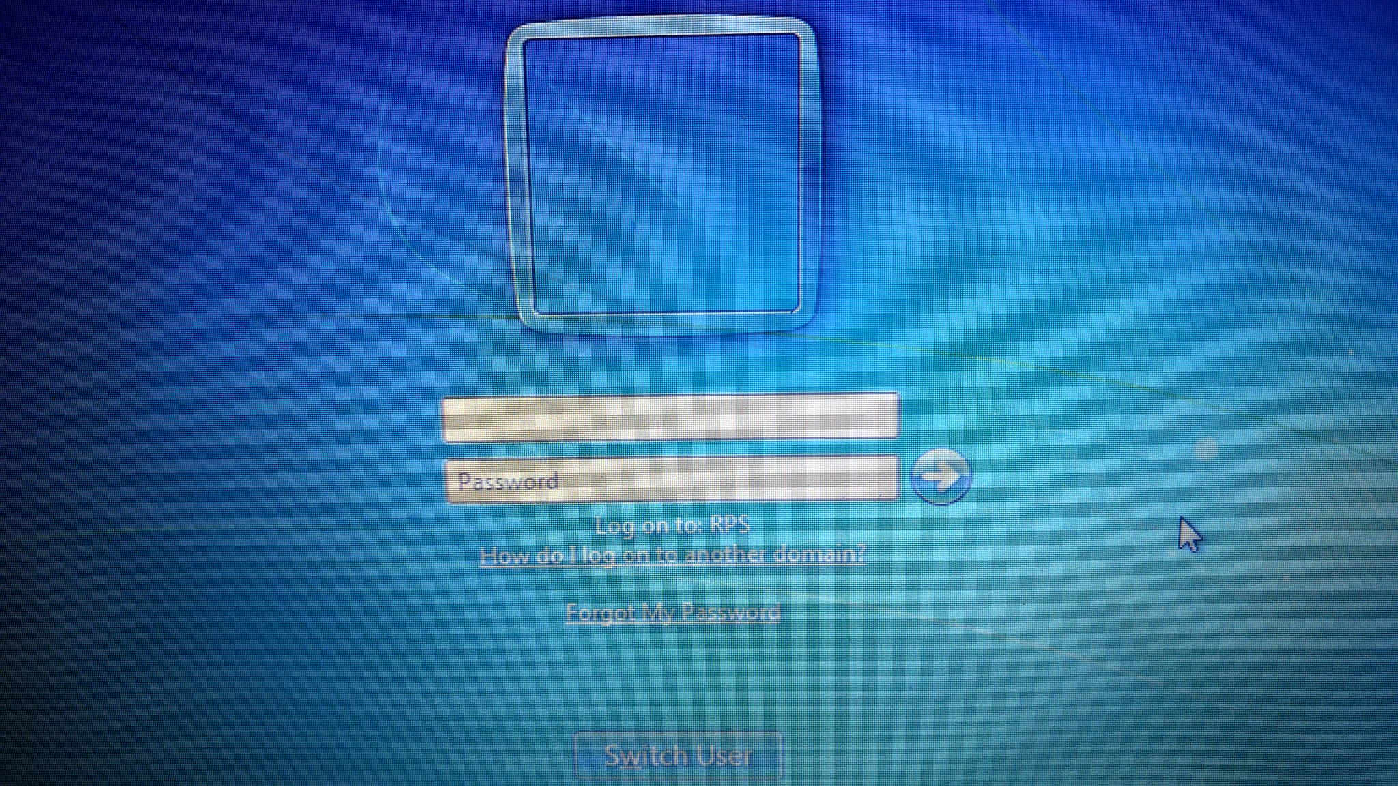
Active Directory Account
Credentials:
Username: Name before the @
Password: Must change every 90 days. At least 8 characters: a capital letter, a number, a punctuation
You will use this to log on to a computer, for your email, and Aspen

Slide 4
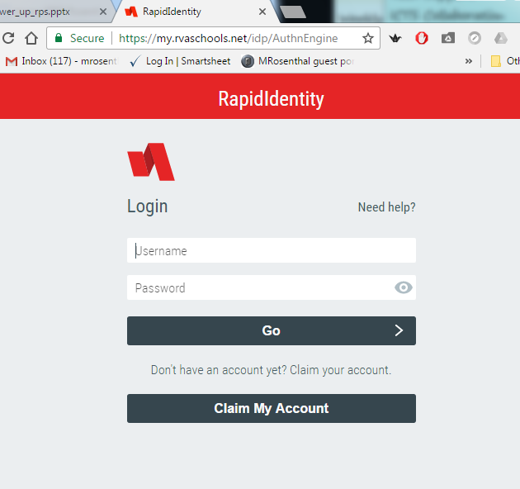
Forgot My Password?
Set this up as soon as you change your password.
Web address: my.rvaschools.net
Log in with your AD credentials

Slide 5
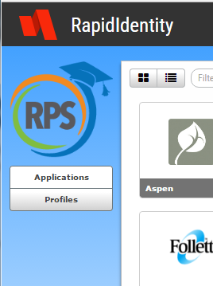
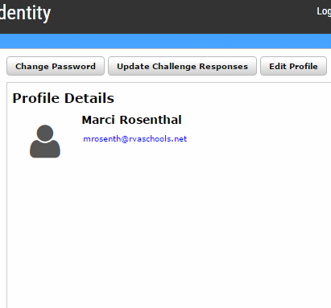
Forgot My Password
Select: Profiles
2. Select: Update Challenge Responses

Slide 6
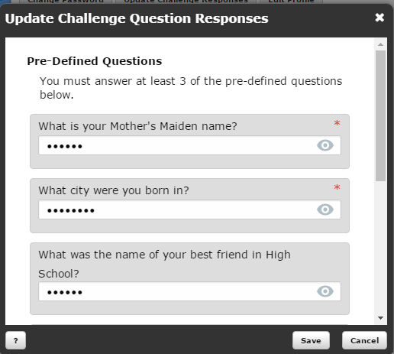
Forgot My Password
Answer the Question
Click: Save
Make sure to update this when you have to change your password.

Slide 7
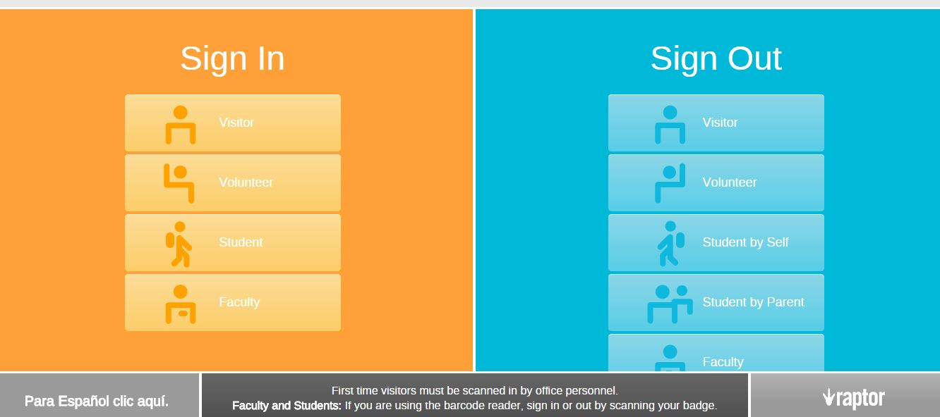
Raptor
The office manager at your school will help you get set up
Tip: to save time all you have to do is enter your 6-digit number and hit Enter and you will be logged in

Slide 8
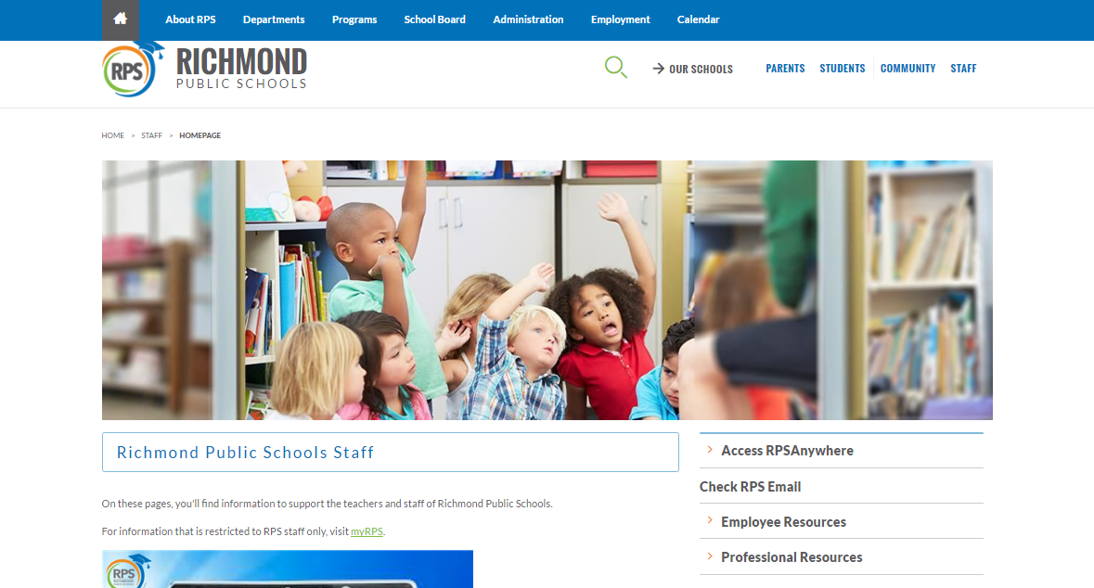
Notes:
The rectangle over Richmond Public Schools is a link to the website

Slide 9
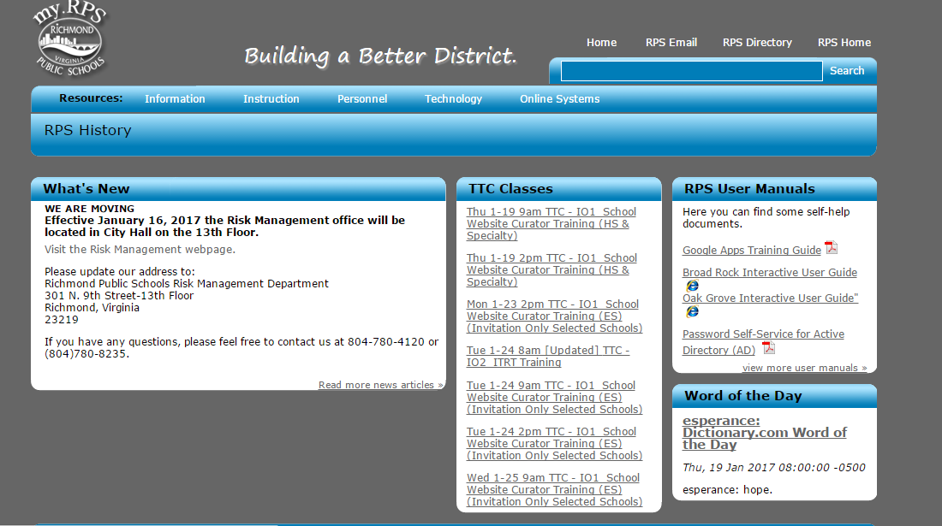

Slide 10
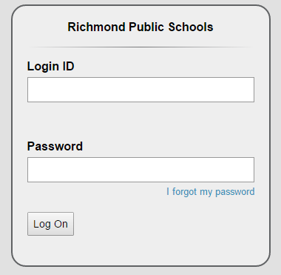
https://aspen.rvaschools.net
Active Directory login
Ex. ssmith
Active Directory password
Gradebook
Attendance
Referrals

Slide 11
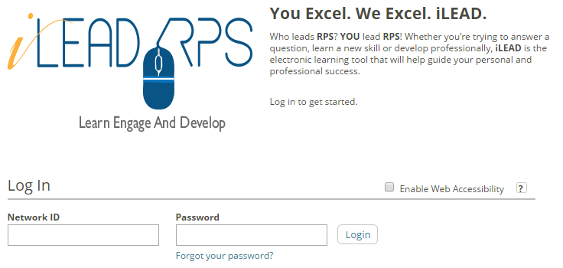
https://ileadrps.skillport.com
First time - rps123 (can be changed)
RPS email address
Contact Person: Donald Bautista dbautis@rvaschools.net

Slide 12

Absence Reporting
https://richmondps.eschool
solutions.com/
First Time Users - Your user ID and password should be your 6-digit ID if that doesn’t work Call Effie White 780-7787
Notes:
We need to research who exactly to contact for special pin for this perhaps human resources

Slide 13
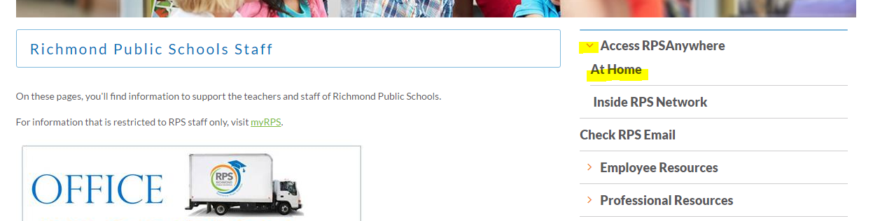
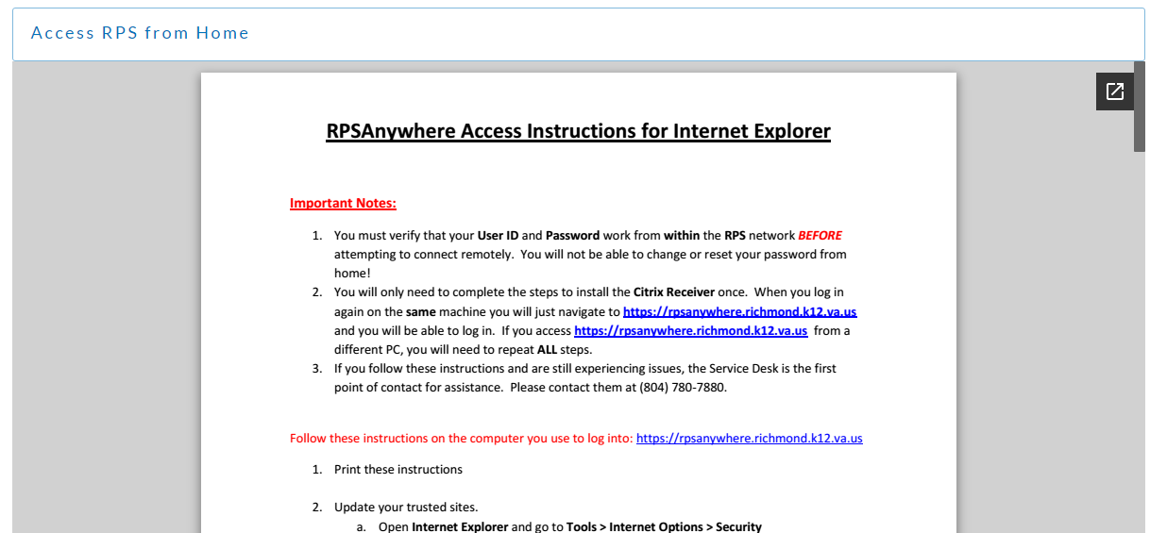

Citrix - how you will access RPS secure systems from home
At home, on your personal computer, follow these directions to the letter!

Slide 14

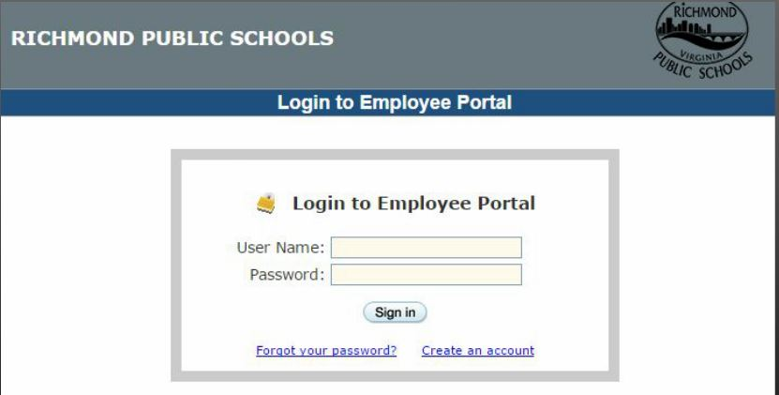
Employee Portal = Payroll
https://cims-portal.rps.edu/employee/login.php
First Time Users!
Notes:
Add the issues about explorer only and id is actually social, how to retrieve password(myrps)NEW SLIDE NEEDED , citrix factor,

Slide 15
How to Create an Account!

Slide 16


Computer Problems?
Call 780-7880 option 1
for the
RPS ICTS Service Desk

Slide 17



The ICTS Service Desk handles: printer installations, password resets, hardware malfunctions, software installations, networking issues and general troubleshooting.
You can also email to create a service ticket:
servicedesk@rvaschools.net

Slide 18

Your ITRT can help
Smartboard Hardware Issues
Creation and Execution of Smartboard Resources
Location and Integration of Online Resources
Collaboration for Integration
Training for Online Systems, Resources, and Equipment
Software questions and assistance
Online Testing Support
Have you met your ITRT yet?

Slide 19
CLASSROOM RESOURCES
Technology Survival Guide for Teachers new to RPS
sithawenberg.weebly.com

Slide 20
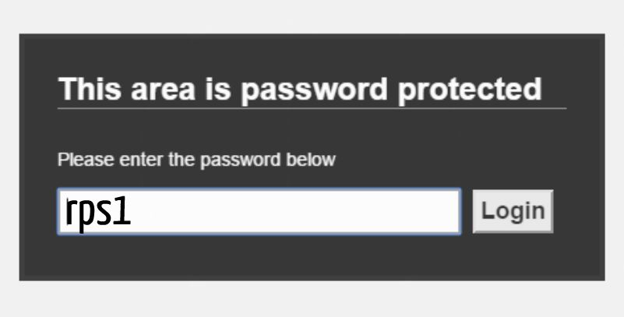
rpstech.org

Slide 21


Notes:
I have added a link to the rpstech page. Just touch the rps icon at the top

Slide 22
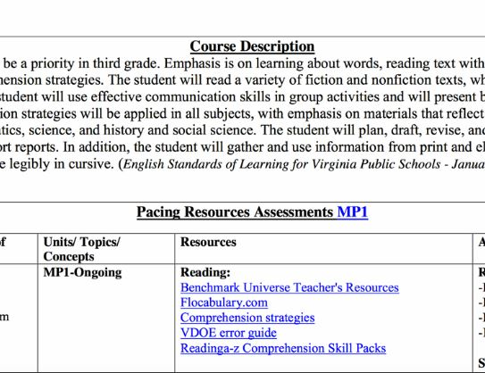
CPR = Curriculum + Pacing Charts + Resources

Slide 23
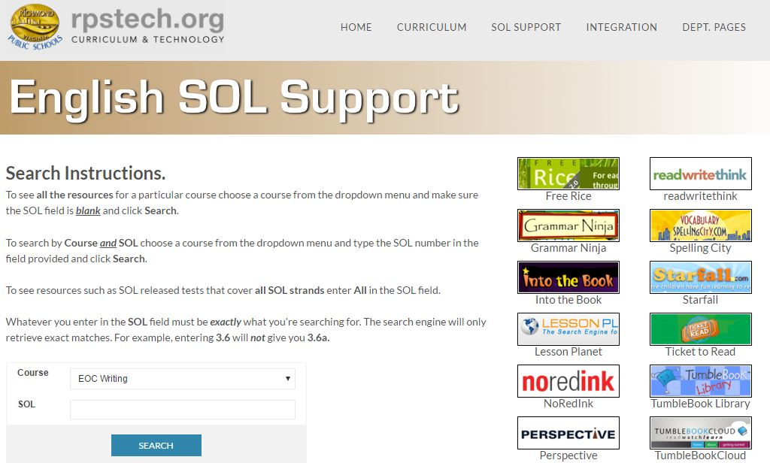

Slide 24
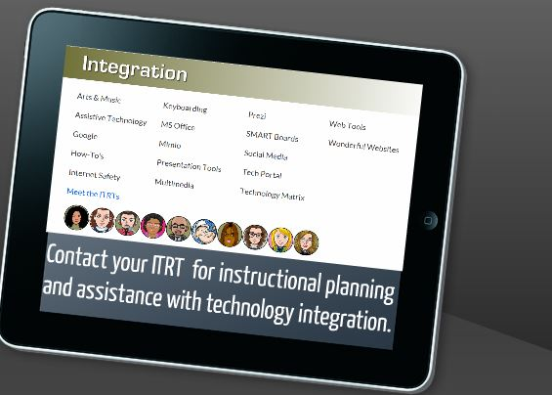

Slide 25
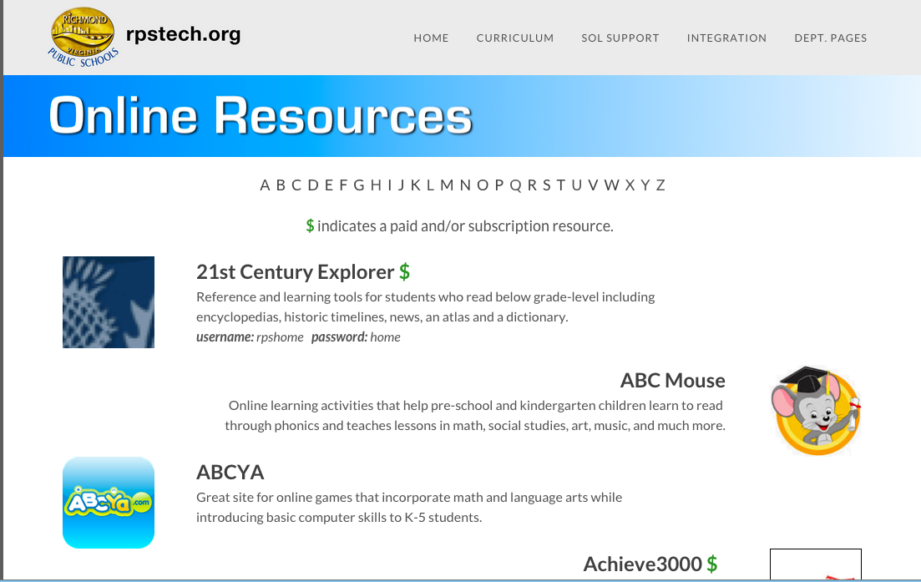

Slide 26

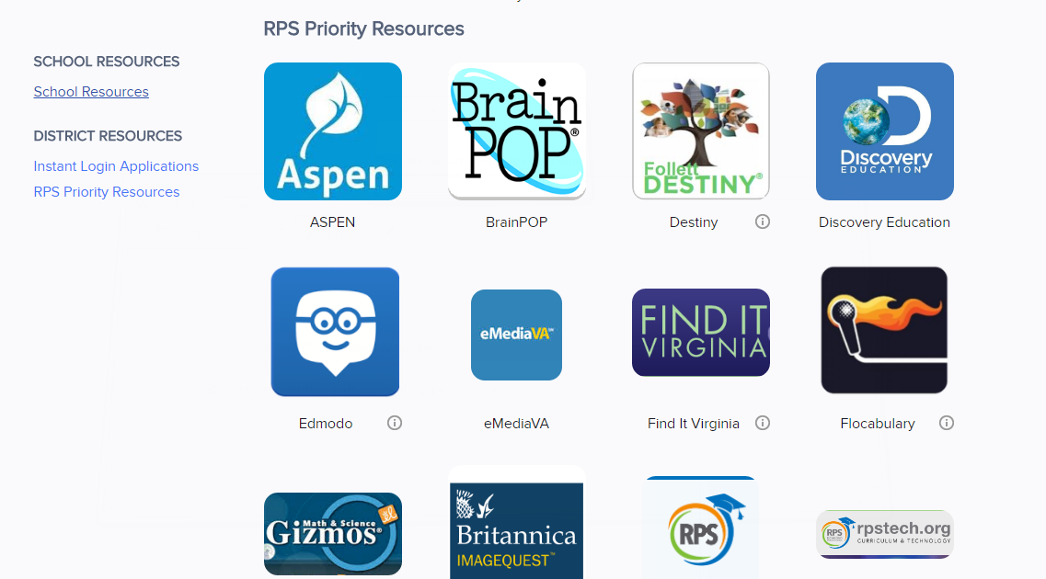
Clever is a single sign-in portal that will allow RPS teachers and students to access many learning applications using a single login and password. Other links take you to sites where you may have to log on separately.

Slide 27
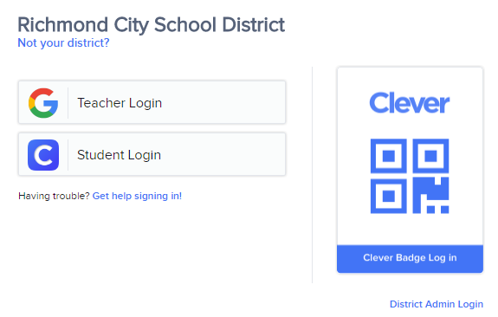

clever.com/in/richmond
Use your gmail log in
Available for K-2

Slide 28

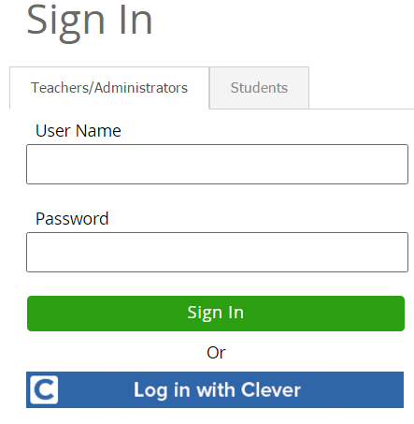
Benchmark or 9-week testing
Teacher-made bi-weekly or unit tests
*** LDS is a great tool.

Slide 29

NWEA-MAP
Grade levels for NWEA-MAP testing for RPS Student's’:
Designed for grades k-12.
NWEA-MAP available test:
Mathematics, language, general science, reading.
Teacher/Proctor log in: https://richmondva-admin.mapnwea.org
Students log in using secure browser on desktop

Slide 30

Discovery Education
http://www.discoveryeducation.com/
See your LIbrarian or ITRT for passcode to set up your own account (different code for @ schl).
Stream or download videos, Use Lesson plans and clip art, Create a profile to save information.

Slide 31
DISCOVERY EDUCATION CODES- Secondary
Binford D959-6433
Boushall 0CFC-B24A
Brown EE32-533E
Elkhardt 5586-1170
Henderson 9B89-E9D2
Hill 8F9B-66C2
MLK D95A-C8C6
Thompson 9F28-1630
ACDC D952-C895
Armstrong D959-32C5
Community 2A11-D82F
Franklin D958-1BF9
Huguenot 5DC1-121F
Marshall 5EBE-B579
Open D959-FB12
RTC 331C-6C94
TJ 6A24-3286
Wythe 5917-4489

Slide 32

TumblebookCloud (Middle/High)
A collection of fiction and nonfiction books, suited for secondary students. Username and/or password is not required when going thru the Library of Virginia.
http://www.finditva.com/

Slide 33
Flocabulary
Videos and activities that promotes academic achievement (i.e. vocabulary improvement)
in all subject areas.
http://www.flocabulary.com
Generic student code: richmondcps
Or, you can create a class and students can log in to your class with the code you provide
https://www.flocabulary.com/accounts/activation-process/richmond-city-pblc-schs-2/
https://www.flocabulary.com/join-class/
Notes:
Teachers can use the generic student code if they don’t want to set up their own account. Otherwise teachers can create classes and have students join with their specific codes.

Slide 34
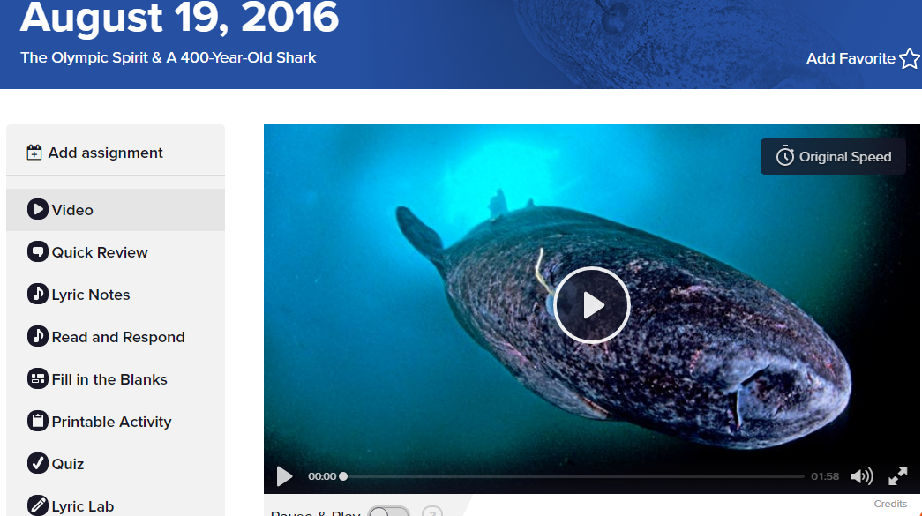
MY FLOCABULARY CLASS
You can create classes and make assignments

Slide 35

Brainpop and Brainpop Jr.
http://www.brainpop.com/
Games, animated videos, and review activities
Generic login:
username: rpschools
password: richmondpub1
You can also create your own account, set up your class, and have your students join your class. See your ITRT for your school code.

Slide 36

Gale
www.gale.com
Hundreds of online professional learning titles: read on laptop or mobile device.
Check with your media specialist for access code for your school. password: schools

Slide 37

eMediaVA
100,000+ free innovative and SOL aligned learning objects and content for the classroom
  Videos, lesson plan supplements, images & worksheets
Offered through PBS - www.emediava.org
Contact your ITRT for an account

Slide 38
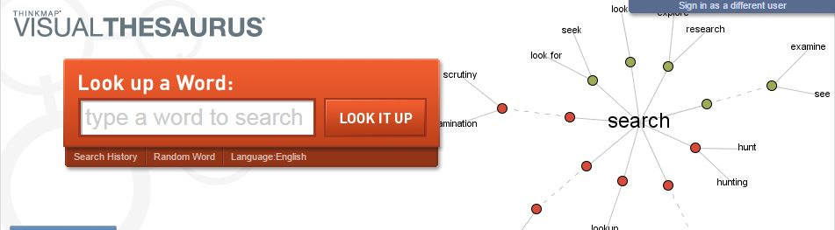
VISUAL THESAURUS
http:richmond.visualthesaurus.com
Username students@richmond.k12.va.us
Password richmond

Slide 39

TurnItIn
TurnItIn detects plagiarism. Teachers upload a paper or other writing sample to the website where it is run through a database. The website then presents an Originality Report with a Similarity Index score that shows matches.
www.turnitin.com
Contact your ITRT for an account

Slide 40
NoRedInk
NoRedInk helps students improve their skills with engaging material — and to allows the teacher to track their progress over time.
A fun way to practice and master grammar & writing skills!
High-interest content- NoredInk generates questions from each student’s favorite celebrities, hobbies, TV shows, and friends.
Authentic assessments, Blended learning, Adaptive technology, and Unlimited practice
www.noredink.com
See your ITRT for an account

Slide 41

Encyclopedia Britannica
http://school.eb.com
Online encyclopedia for references
No password needed at school
From home: Username: rpshome
Password: home

Slide 42

Image Quest
http://quest.eb.com
21st Century Explorer
http://explorer.eb.com
Spanish Reference Library
http://spanish.eb.com
Username: rpshome
Password: home

Slide 43

Find it VA
http://www.finditva.com/
Free access to online resources from your local Virginia library
(while on the RPS network)

Slide 44

WorldBookOnline.com
username= rpshome
password= home

Slide 45

TeachingBooks.net
Lesson plans and activities related to books.
username: rps email address
password: Richmond

Slide 46

Microsoft Office
Available for FREE for teachers through the Home Use Program
http://my.rps.edu - Personnel - Employee Discounts

Slide 47

Gizmos: ExploreLearning/Math & Science
Online solutions that help increase students skills in math and science.
http://blog.explorelearning.com/
Create an account here:
http://www.explorelearning.com/register/QHT6NR9C

Slide 48

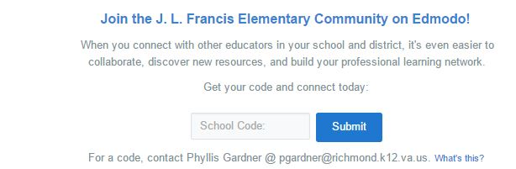
Edmodo
richmondcity.edmodo.com
Enter your school code (get from your ITRT)

Slide 49
SECONDARY EDMODO CODES
Albert Hill Middle yl9zhm
Binford Middle 00swkh
Elkhardt - Thompson Middle drkygh
Henderson Middle f8x411
Thomas C. Boushall Middle ooetpb
Lucille M. Brown Middle ylr5hg
Martin Luther King JR. Middle 7u66b3
Armstrong High 1291u4
George Wythe High jiju4a
Huguenot High 4xeck1
John Marshall High w100ka
Open High 7q0jm1
Richmond Community High gy319h
Thomas Jefferson High dzixx9
Franklin Military Academy 5qlg19
Richmond Technical Center tapgsj

Slide 50
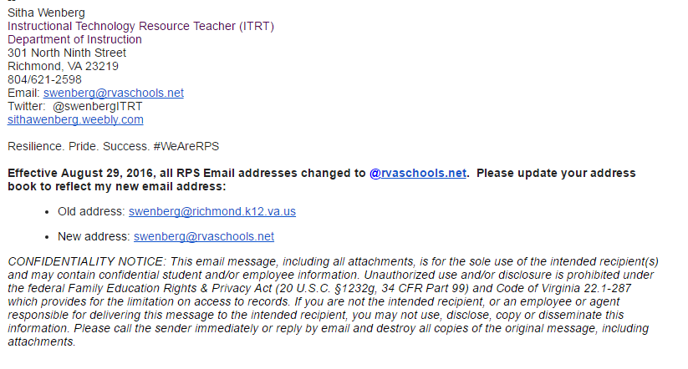
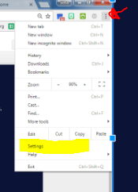
One last thing...
Set up your email signature. I will email you. Copy and past the bottom of the email into your email settings. This is a good time to add a photo, too.

Slide 51
Sitha Wenberg
Teacher Resource Website:
Sithawenberg.weebly.com
swenberg@rvaschools.net
Technology Survival Guide for Teachers New to RPS

Slide 52
Dina Logo
MY WEEBLY HTTP://DLOGO.WEEBLY.COM
My Portaportal Http://guest.portaportal.com/dlogo1

Slide 53
Brent Evans
Teacher Resource Wiki
http://evansitrt.pbworks.com
Teacher Website
http://www.schoolrack.com/bevans

Slide 54
Marci Rosenthal
Teacher Wiki Page
Rosenthal.pbworks.com
Portaportal Site
http://guest.portaportal.com/mrosenthal

